Slide 1
CodeAcademy Unlocking Solutions for Developers
Team Details :
Raghav Singhal E23CSEU1278
Rushay Gopani E23CSEU1283
Mayank Maletha E23CSEU1290
Deepanshu Dangi E23CSEU1285

Slide 2
Problem Statement
Debugging or Code Optimizing is hard for the developers.
This reduces bugs and errors from happening in your code.
Supports multiple languages (Python, Java, C++ and so on).
AI assistance to suggest code and other related resources.
A freelancing market to get help with coding problems.

Slide 3
Objective
01
02
03
04
Build app & web solution
Code Optimization Smart platform
Easy scalability and maintenance
Earnings from our freelance Platform

Slide 4
Features Overview
AI Debugging: Immediate Error check and Fix.
Code Smells: Optimize Code Readability and Performance.
Find freelance Jobs and Projects .
You can manage Projects, Display skills with custom Dashboards.
Code Versioning + Coding collaboration.

Slide 5
Tech Stack : WEB
Frontend : Reactjs, Next.js, Tailwind CSS3, Html, Javascript
End: Node.js, Express.js
Databse: MySql, Firebase
AI Models: OpenAI API, Transformer

Slide 6
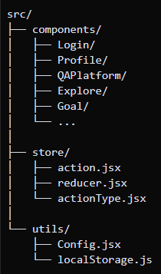
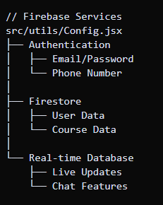
System Architecture : WEB

Slide 7
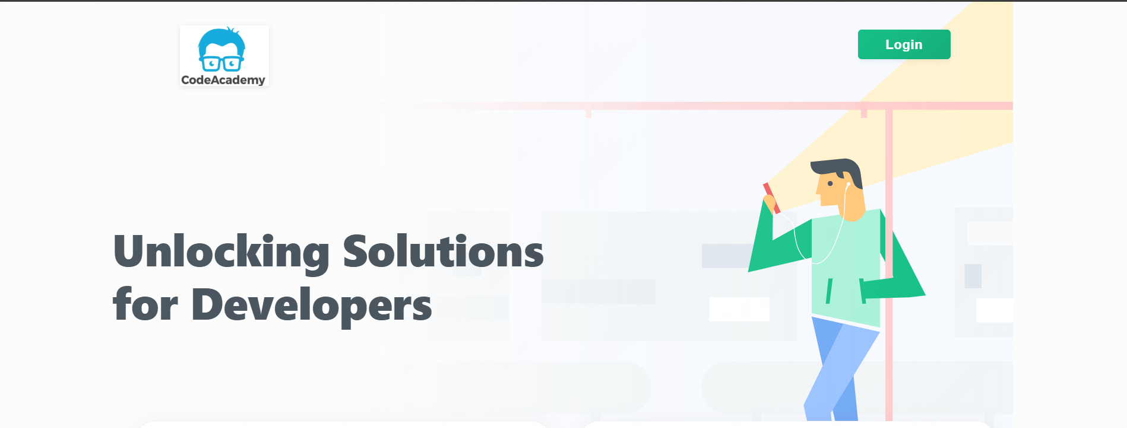
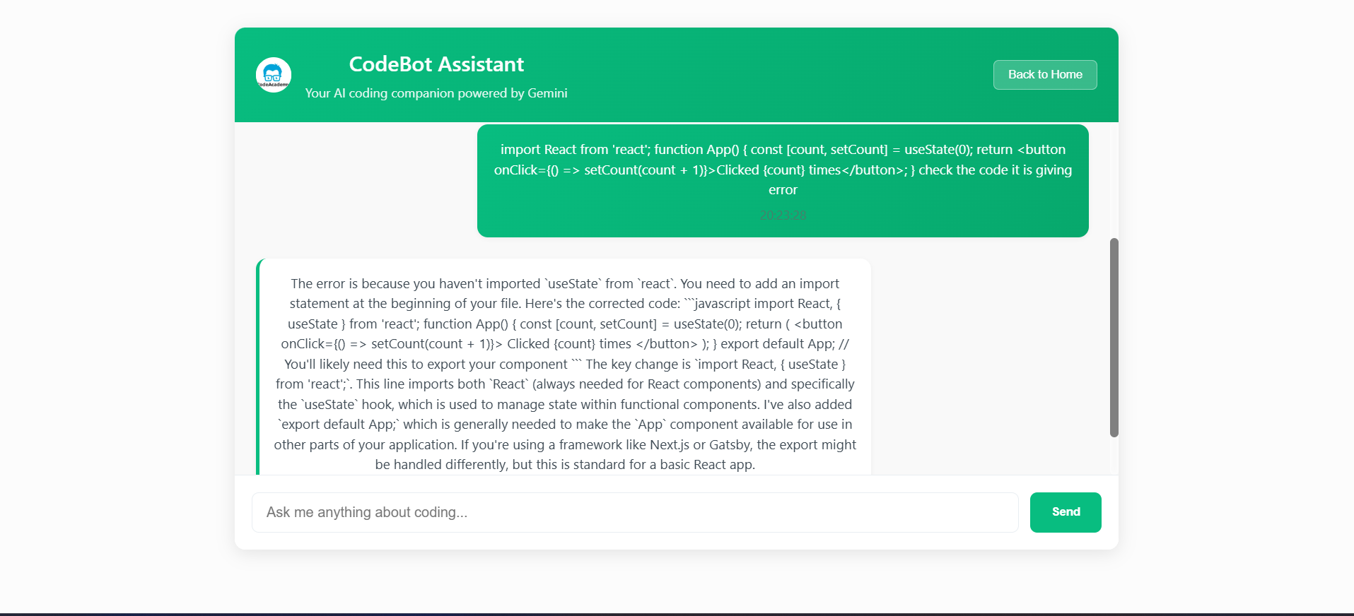
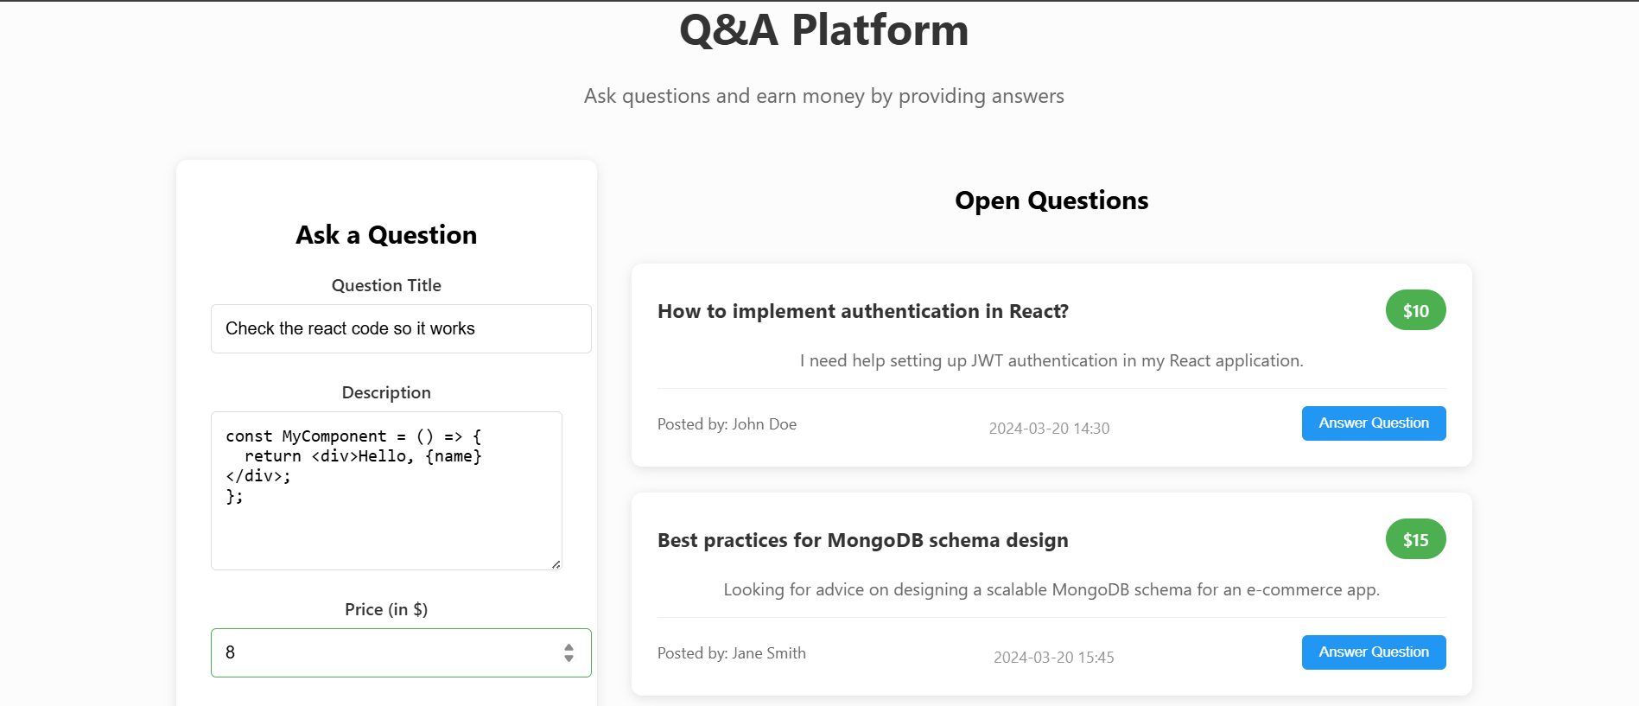

Slide 8
Tech Stack : APP
Design: Figma
Frontend : Flutter, Dart, Kotlin, Java
BackEnd: API’s , Authentication
Databse: MySql, Firebase
AI Models: OpenAI API Model

Slide 9
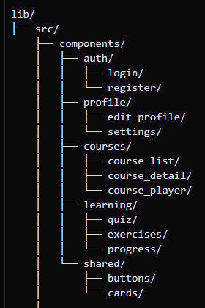
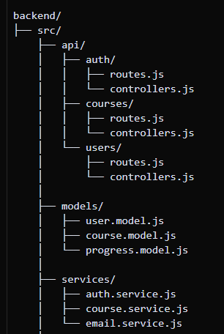
System Architecture : APP

Slide 10
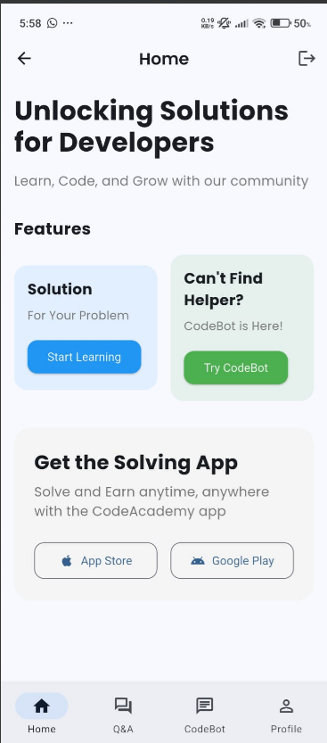
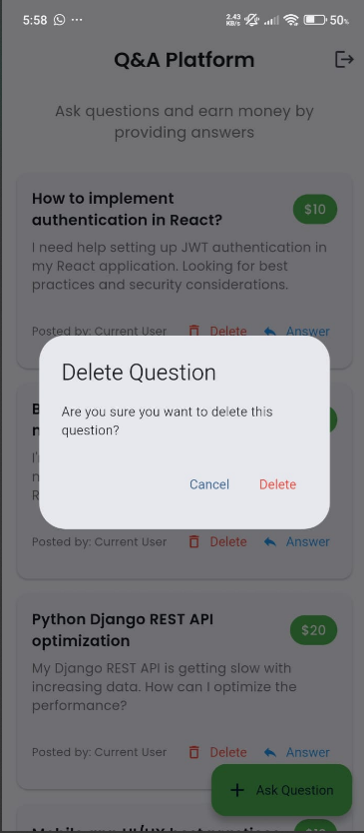
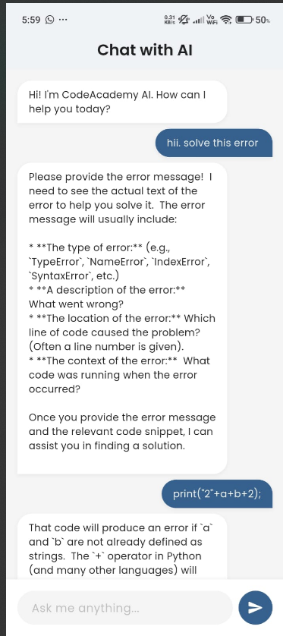

Slide 11
Challenges Faced
Authentication Problem: User login, signup and session handling need to be secured.
State Management: Efficient handling of data flow in the dynamic API.
Integration: Integrating the Front-end and Back-end, AI services like a charm.
Security Point: Secure user data and transactions.

Slide 12
Future Scope
Expand CodeAcademy to further languages, frameworks.
Make smarter AI that debugs and also gives the right code with an additional recommend.
B2B / University and business partners universities as well as tech companies.
Develop certification for coders and freelancers over the platform.

Slide 13
Conclusion
CodeAcademy helps with AI-powered debugging of coding life, along-with a freelancing marketplace.
In one place real-time code analysis and the collaboration.
CodeAcademy Tech Stack, Clear Goals and Smart Planning — to help developers, freelances and companies with their work.
It fixes the coding problems without creating new job openings in tech!

Slide 14
THANK YOU

